Slide 1

International JavaScript conference | Munich, November, 13 2024 | @nilshartmann
NILS HARTMANN
https://nilshartmann.net
Practical
introduction:
Fullstack
with
Next.js

Slide 2


https://nilshartmann.net
NILS HARTMANN
nils@nilshartmann.net
Freelance Software Developer, Architect and Trainer from Hamburg
Java, Spring, GraphQL, React, TypeScript
https://graphql.schule/video-kurs
https://reactbuch.de

Slide 3
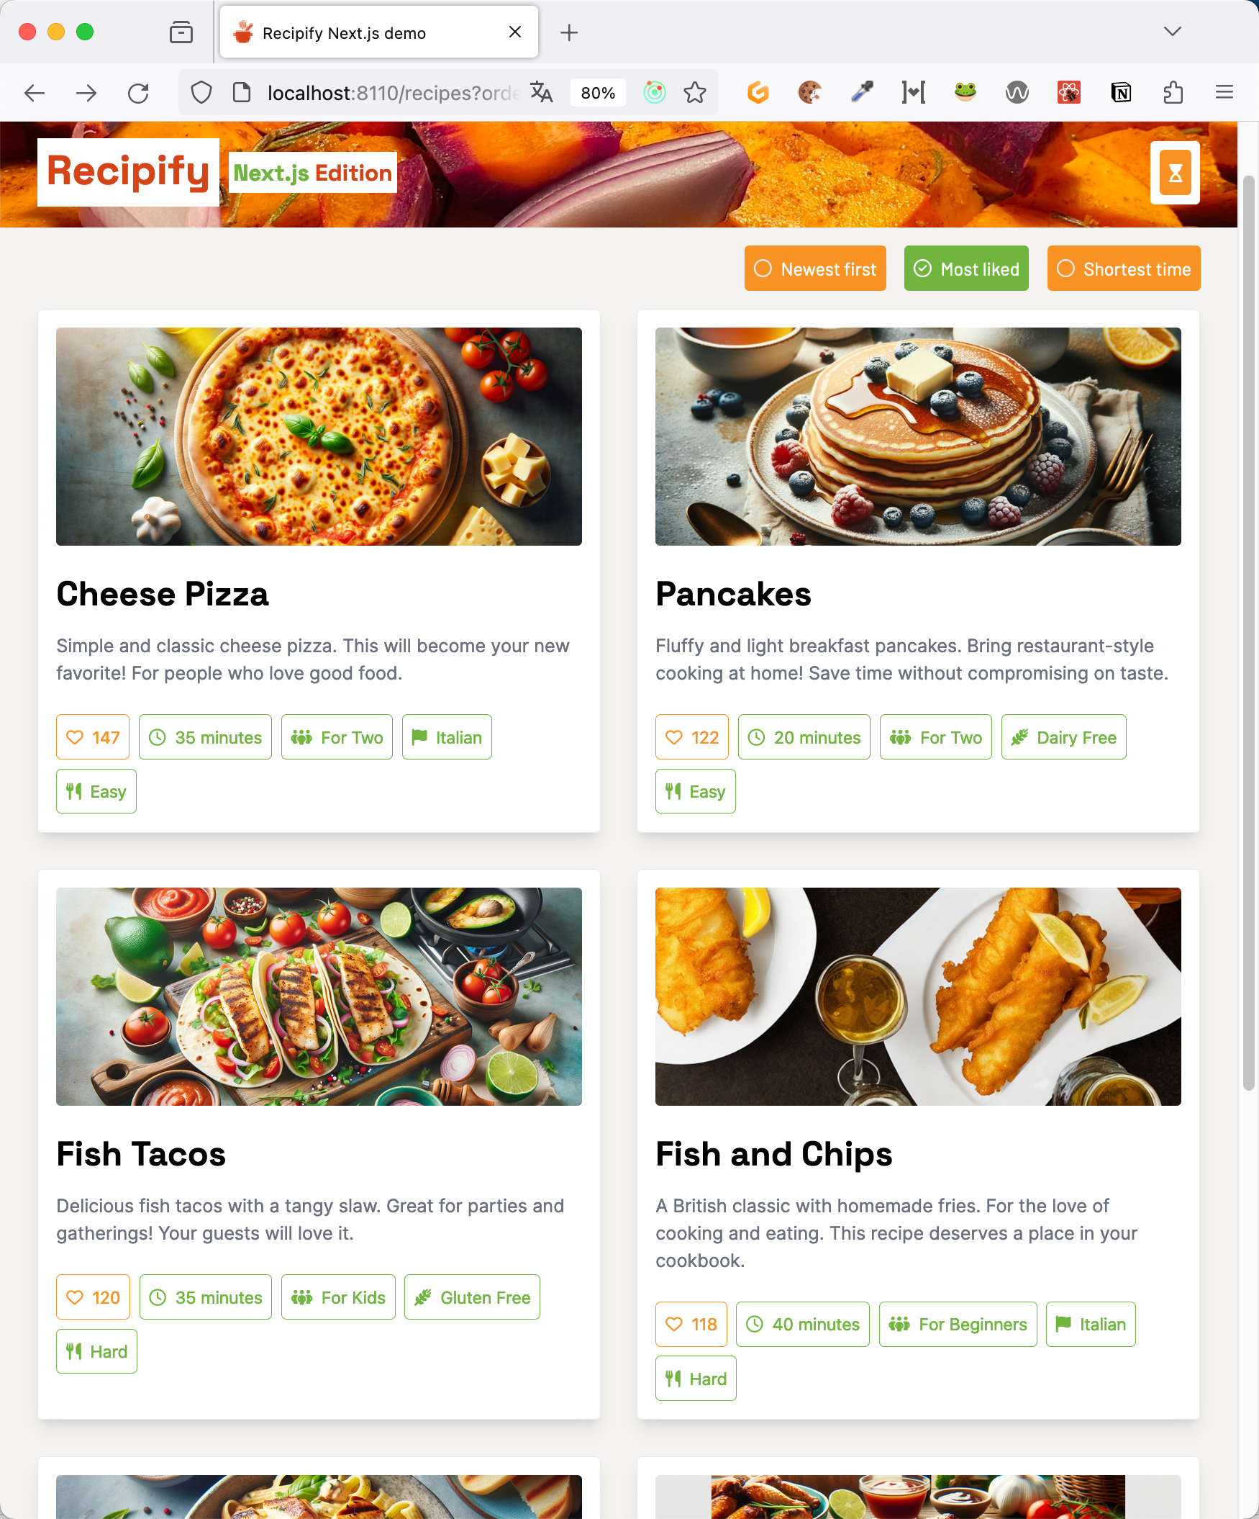
An example...
http://localhost:8110

Slide 4
An example...
What makes up the sample application?

Slide 5
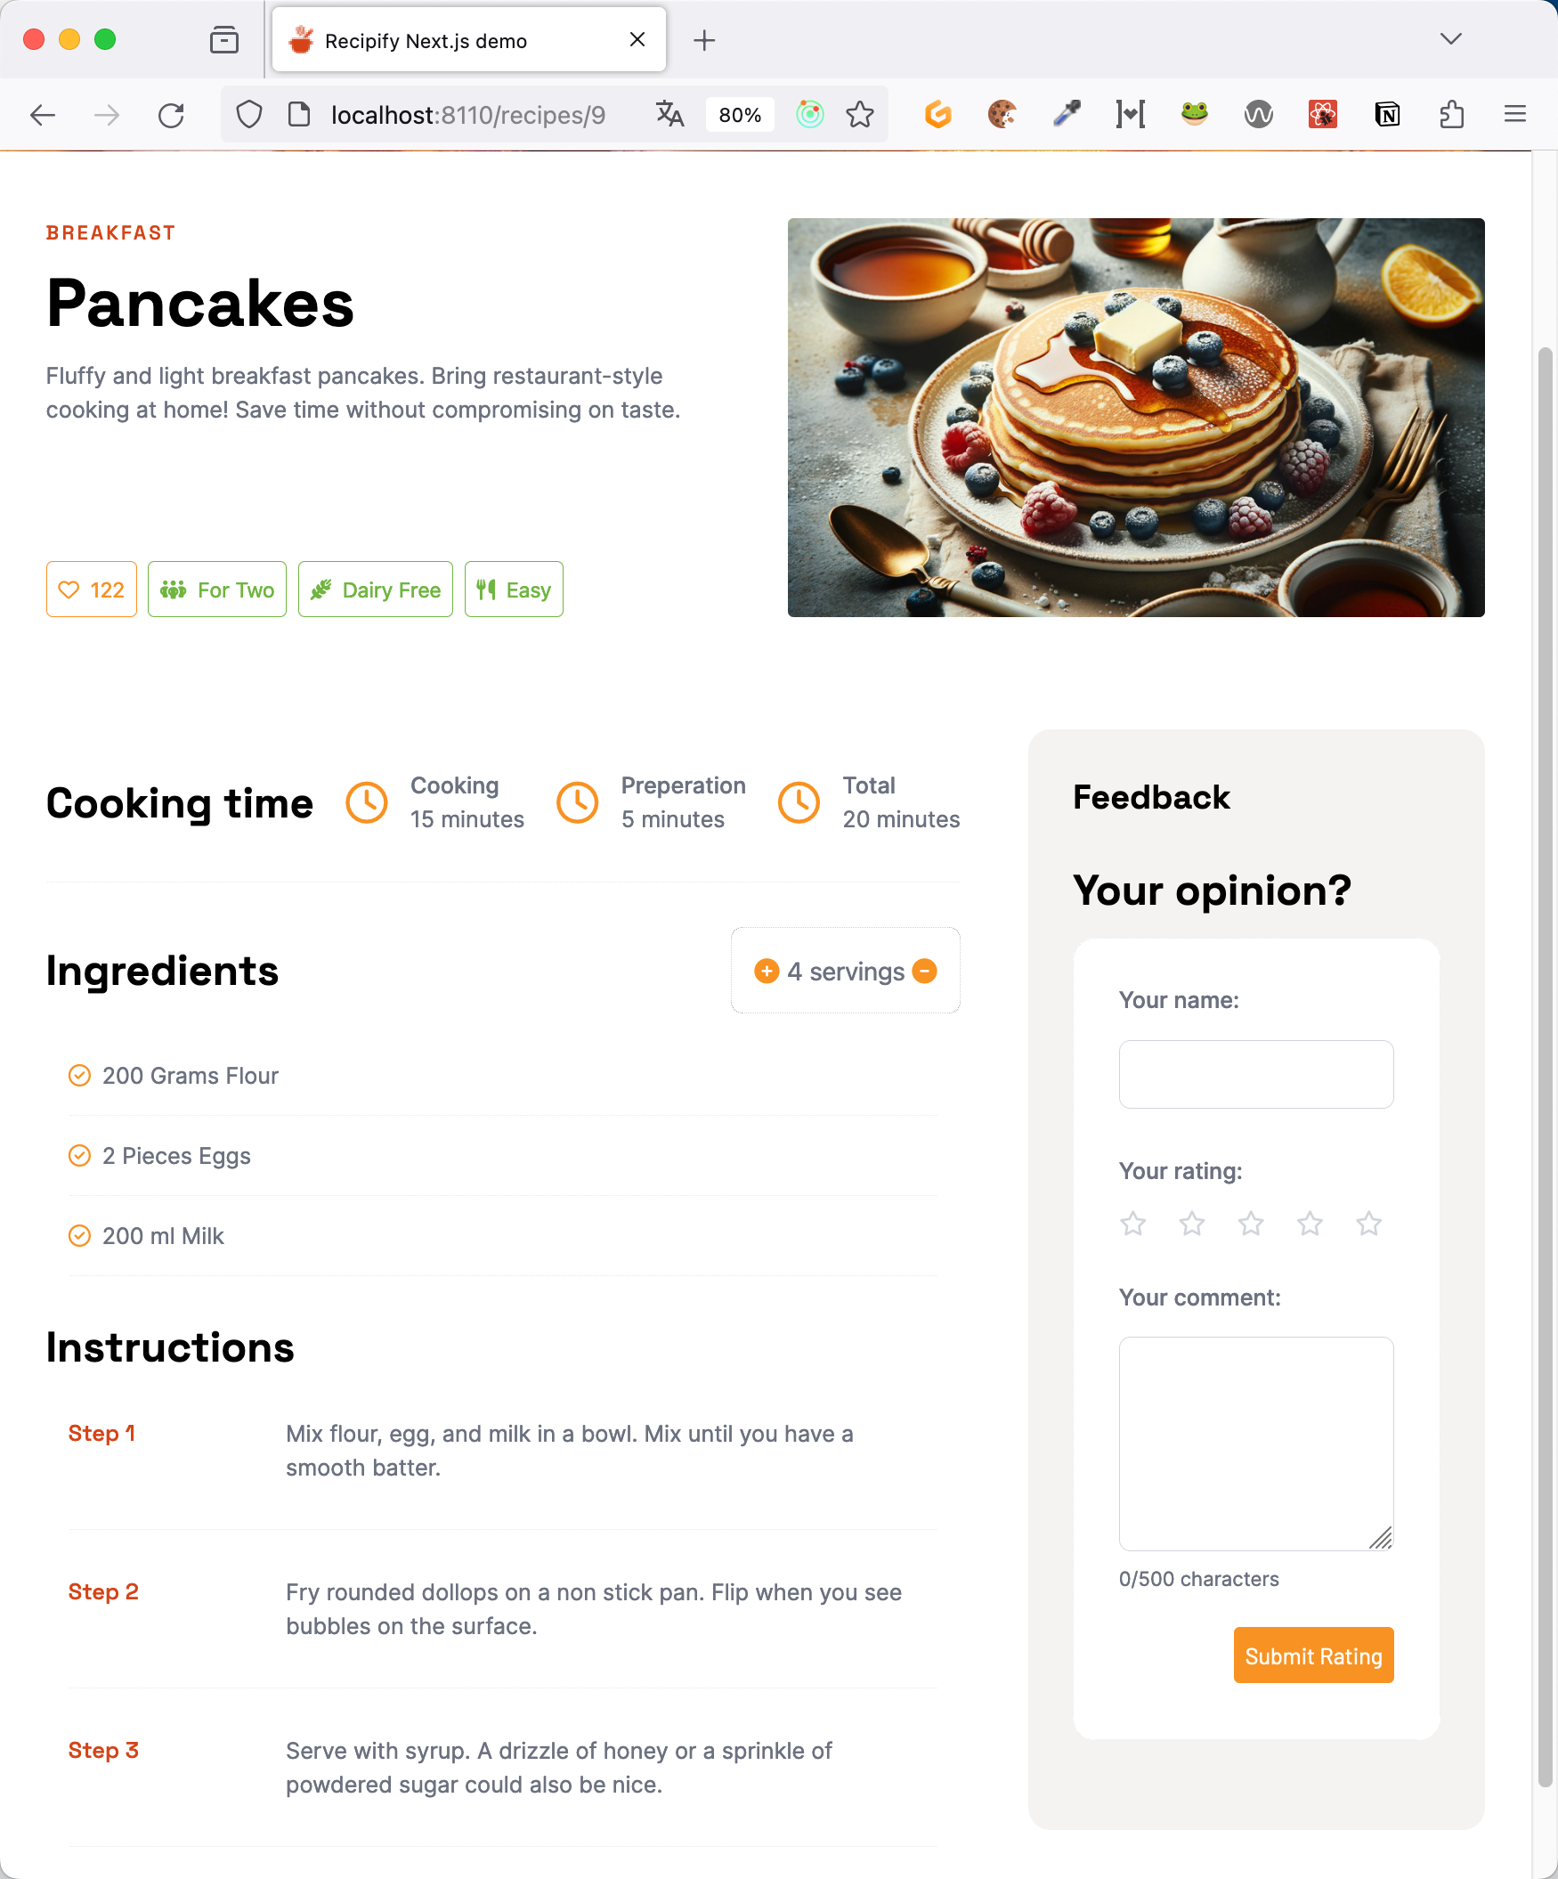
An example...
What makes up the sample application?
Lots of food 😋

Slide 6
An example...
What makes up the sample application?
Some bad AI-generated images
🫣

Slide 7
An example...
What makes up the sample application... technically?
Lots of static content ☺️

Slide 8
An example...
What makes up the sample application... technically?
Lots of static content ☺️
... only a few interactions 🦥

Slide 9
An example...
What makes up the sample application... technically?
Lots of static content ☺️
... only a few interactions 🦥
... does that justify a Single-Page-Application? 🤔

Slide 10
An example...
What makes up the sample application... technically?
Lots of static content ☺️
... only a few interactions 🦥
... does that justify a Single-Page-Application? 🤔
...huge amount of JS in the browser?
...no caching of content?
...not best possible SEO?

Slide 11
React
Server
Components

Slide 12
different Kinds of components
Kinds of components

Slide 13
different Kinds of components
Client components (as known before)
Rendered on the Client

Slide 14
different Kinds of components
Client componenten (as known before)
Rendered on the Client
or on the Server 🙄 (SSR)

Slide 15
different Kinds of components
Client componenten (as known before)
Rendered on the Client
or on the Server 🙄 (SSR)
JavaScript-Code is sent to the browser
They can be interactive and can held state

Slide 16
different Kinds of components
New: React Server Components

Slide 17
different Kinds of components
New: React Server Components
are rendered on the Server

Slide 18
different Kinds of components
New: React Server Components
are rendered on the Server
or during Build 🙄

Slide 19
different Kinds of components
New: React Server Components
are rendered on the Server
or during Build 🙄
returning UI (!) to the browser (but no JavaScript-Code)

Slide 20
different Kinds of components
Different kinds can be used together
From JSX perspective they look the same
Server Components
Client Components

Slide 21
Next.js

Slide 22
next.js
Next.js
sits on top of React

Slide 23
next.js
Next.js
sits on top of React
Some features are React standard, mainly React Server Components

Slide 24
next.js
Next.js
sits on top of React
Some features are React standard, mainly React Server Components
Those could be implemented by other frameworks too

Slide 25
next.js
Next.js
sits on top of React
Some features are React standard, mainly React Server Components
Those could be implemented by other frameworks too
in the demo we will see Next.js and React features

Slide 26
next.js
Next.js
sits on top of React
Some features are React standard, mainly React Server Components
Those could be implemented by other frameworks too
in the demo we will see Next.js and React features
This features are available in the App Router (Next.js 14+)

Slide 27
next.js
Next.js
You need to run Next.js in production on a server

Slide 28
next.js
Next.js
You need to run Next.js in production on a server
that's a big difference to single-page-applications

Slide 29
next.js
Next.js
You need to run Next.js in production on a server
that's a big difference to single-page-applications
Both Next.js and React are also running in the browser

Slide 30
👩‍🍳
Demo

Slide 31
Demo
Server Components #1
/recipes with fetchRecipes
where is the component rendered?
Console.log
React Dev Tools
how can we order and filter the list? we do not have state here!
what is refetched when we re-order the list? -> Network tab!
what is fetched when we re-load the page -> Network tab!

Slide 32
Demo
Next.js: Layout component
/recipe/layout.tsx la
Look at the timer!

Slide 33
Demo
Server Components #2: Suspense
/recipe/[recipeId]/page.tsx. rp
notFound
slow_down in demo-config.ts
Add loading.tsx

Slide 34
Demo
Server Components #2: Avoid waterfalls
In RecipePageContent, Feedbacks are fetched
slowdown_feedback
Add Suspense Boundary
What do we have now: Request takes Recipe-Request + Feedback-Request

Slide 35
Demo
Server Components #2: Avoid waterfalls
Move fetchFeedback to [recipeId]/index.tsx
Pass feedbackPromise to RecipePageContent
Adjust <FeedbackList ...> in RecipePageContent
Adjust FeedbackList to await promise

Slide 36
Demo
Server Actions: A very simple form
LikeWidget "use server"
This works without JavaScript!
Note: with the new React 19 Hooks useActionState, useFormStatus, useOptimistic we could also build "real" forms that are progressively enhanced

Slide 37
Demo
Client Components: Now we need JavaScript in the Browser
Show desired result in working application
RecipePageContent: replace IngredientsSection with ConfigurableIS
Note:
we pass props "as normal" from server to client components
that even works for promises!
we can use Server Functions to execute code on the server (no endpoint required)

Slide 38


NILS HARTMANN
https://nilshartmann.net
Thank you very much!
Slides & Code: https://react.schule/ijs-nextjs
Questions and contact:
nils@nilshartmann.net
https://nilshartmann.net/contact

